Slide 1



IT 493 Assignment 8
Training Plan
Tour Catchers LLC
Team #4
Tour Catchers LLC​ – Team 4
1

Slide 2
PURPOSE OF TRAINING
Web/Mobile Booking Application
Bitrix CRM Platform
Dialpad AI Chat Assistant
Training prepares Tour Catchers LLC to independently operate and sustain:
Accurate data management
Reduced operational errors
Long term sustainability after capstone handoff
Training ensures:
Proper system adoption
Tour Catchers LLC​ – Team 4
2

Slide 3
Sprint 4/5 → Full Integration + UAT
Sprint 2 → Booking Application
Sprint 3 → CRM + AI
TRAINING STRUCTURE
Each course includes:
• Defined audience • Learning objectives
• Hands on practice • Competency validation
Tour Catchers LLC​ – Team 4
3

Slide 4

COURSE 1: WEB BOOKING APPLICATION
Audience:
Sponsor
Reservation Staff
Hands on Requirement:
Complete full mock booking including payment and confirmation.
Core Modules:
System workflow overview
Booking submission process
Payment integration
Admin controls
Error handling
Objectives:
Complete end to end booking
Process payments and refunds
Modify itineraries
Generate booking reports
Troubleshoot booking errors
Participant must complete workflow with zero system errors.
Tour Catchers LLC​ – Team 4
4

Slide 5
COURSE 2: BITRIX CRM
Audience:
Objectives:
Core Modules:
Hands on Requirements:
Sponsor
Support Staff
Manage centralized customer records
Monitor booking pipelines
Configure automated follow ups
Interpret analytics dashboards
Customer profile management
Automation workflows
CRM integration with booking system
Reporting and analytics
Create client profile, simulate booking sync, and trigger automation rule
Confirm booking data automatically populates CRM fields
Tour Catchers LLC​ – Team 4
5

Slide 6
COURSE 3: DIALPAD AI
Simulate inquiry, confirm CRM lead creation, then test the escalation
Audience:
Sponsor
Support Staff
Objectives
Manage chatbot logic
Monitor AI performance
Validate CRM lead capture
Core Modules:
AI workflow and response logic
Hands on Requirement:
Execute escalation process
Lead capture and CRM sync
Escalation procedures
KPI monitoring
Tour Catchers LLC​ – Team 4
6

Slide 7
TRAINING:
FORMAT & DOCUMENTATION
Delivery Format:
Guided system walkthrough
Scenario based simulations
Recorded sessions for archive
Documentation Includes:
Structured training manual
Role based instructions
Step-by-step screenshots
Troubleshooting guide
Reference sheets
Sharepoint version control (reusable for future employees)
Tour Catchers LLC​ – Team 4
7

Slide 8
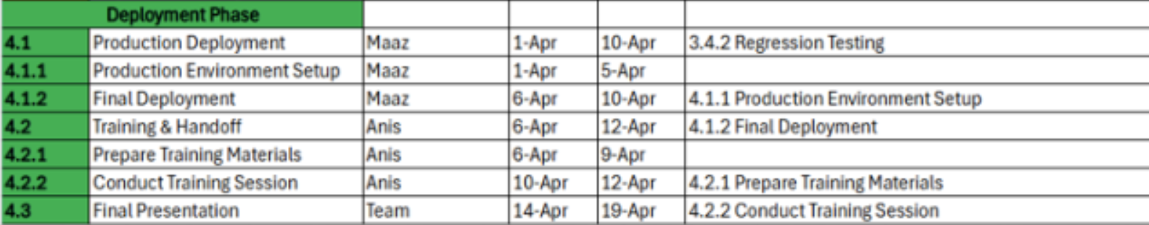
TRAINING SCHEDULE
April 6 - Booking System
April 8 - CRM
April 9 - AI + Integration
April 11 - Full System Simulation
April 12 - Sponsor Validation
Tour Catchers LLC​ – Team 4
8

Slide 9
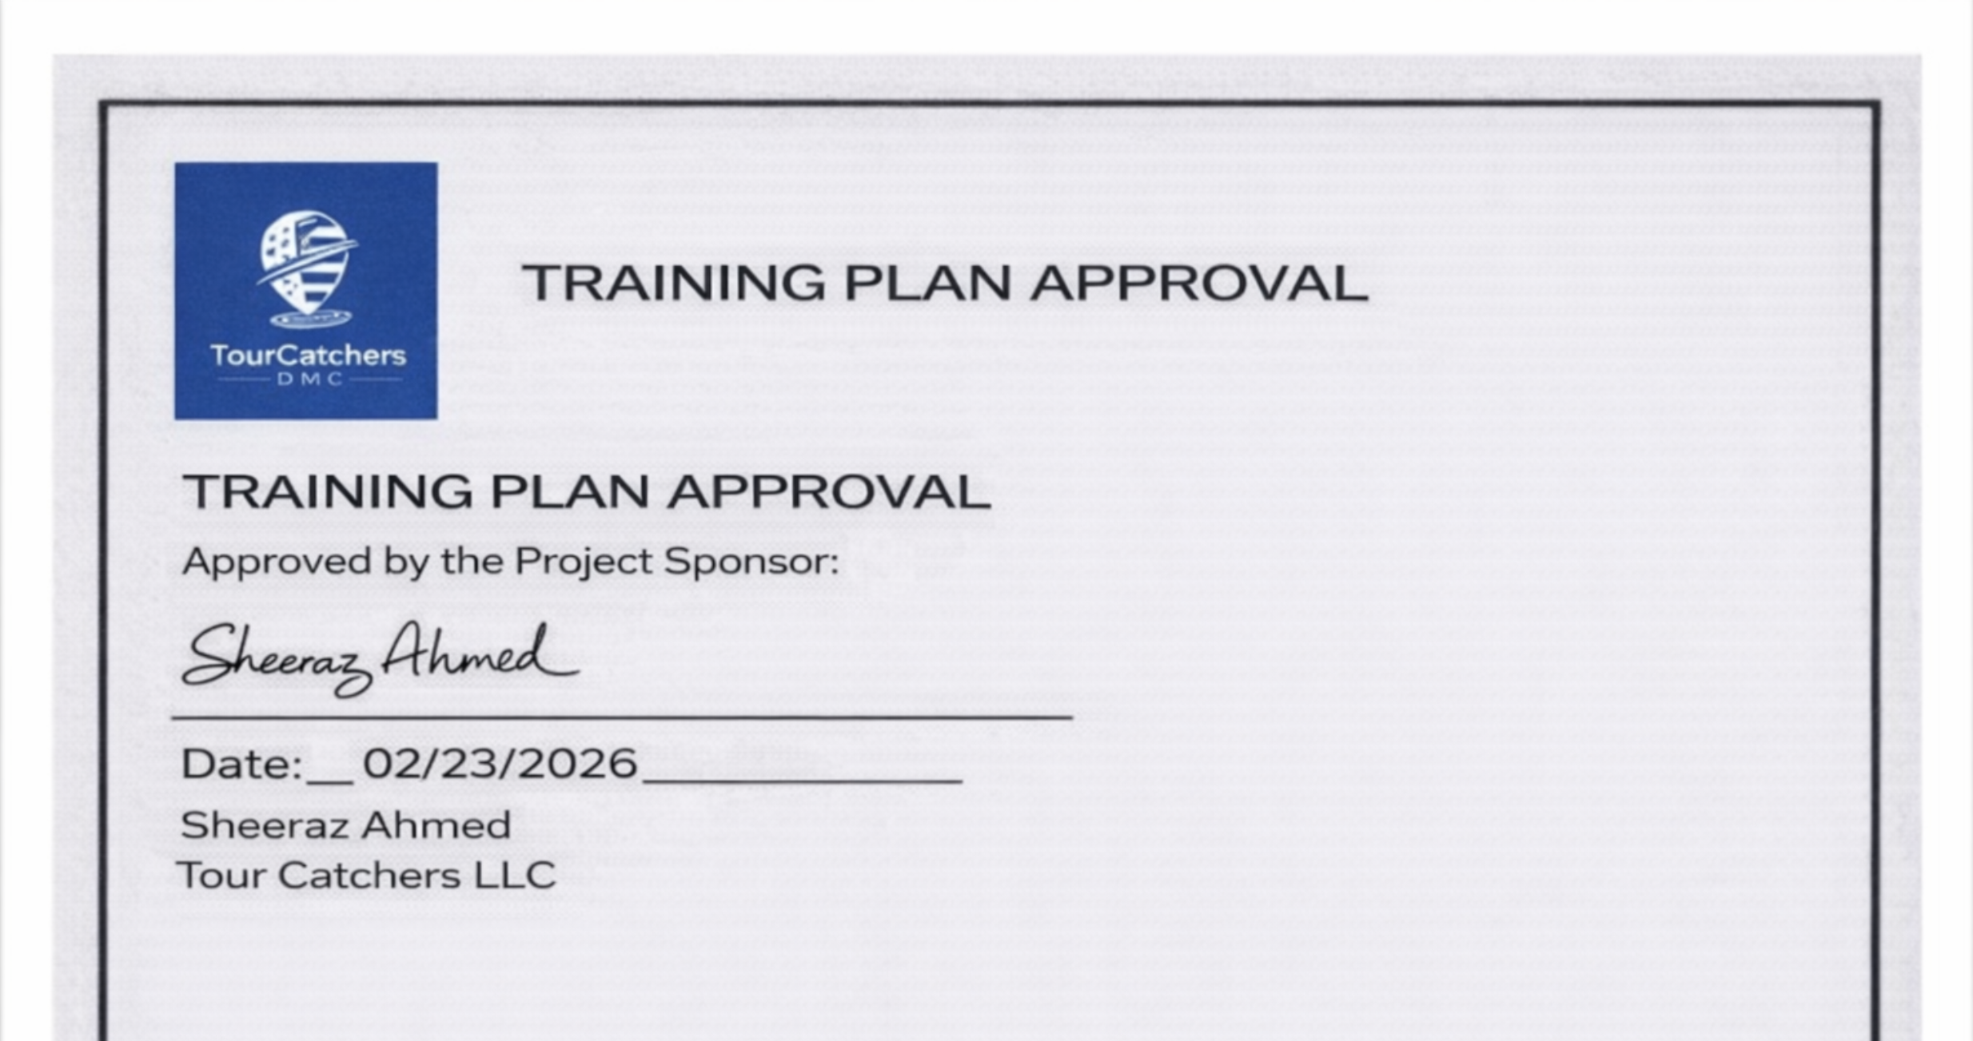

Slide 10

A SINCERE THANK YOU!
TO PROFESSOR HINE AND OUR GTA KIRAN FOR YOUR SUPPORT AND FEEDBACK!
Questions?
Tours Catchers LLC​ – Team 4
10

Slide 11
Citation & References
Team 2026 IT-493 Assignment 1. George Mason University.
Jibran. A (2025). IT-493 Assignment 2. George Mason University.
Team 2026. (2025). IT-493 Assignment 3. George Mason University.
Khan, K. (2025). IT-492 Assignment 2. George Mason University.
Khan, K. (2025). IT-492 Assignment 3. George Mason University.
Khan, K. (2025). IT-492 Assignment 4. George Mason University.
Khan, K. (2025). IT-492 Assignment 5. George Mason University.
Kaur, J. (2025). IT-492 Assignment 6. George Mason University.
Pathak, D. (2025). IT-492 Assignment 7. George Mason University.
Kaur, J. (2025). IT-492 Assignment 8. George Mason University.
Mughal, M. A. (2025). IT-492 Assignment 9. George Mason University.
Mirza, A. (2025). IT-492 Assignment 10. George Mason University.
Ahmad, S. (2025). TourCatchers LLC: Sponsor interview and process input [Personal communication, September 25, 2025].
GeeksforGeeks. (n.d.). Waterfall model. https://www.geeksforgeeks.org/waterfall-model/
GeeksforGeeks. (n.d.). What is agile methodology? https://www.geeksforgeeks.org/what-is-agile-methodology/
TourCatchers LLC project team. (2025). Project team meetings (October 20, November 1, and November 10, 2025).
Waterfall Research| https://www.geeksforgeeks.org/waterfall-model/
Agile Research| https://www.geeksforgeeks.org/what-is-agile-methodology/
Team Meetings
Tours Catchers LLC​ – Team 4
Slide 11

